Slide 1
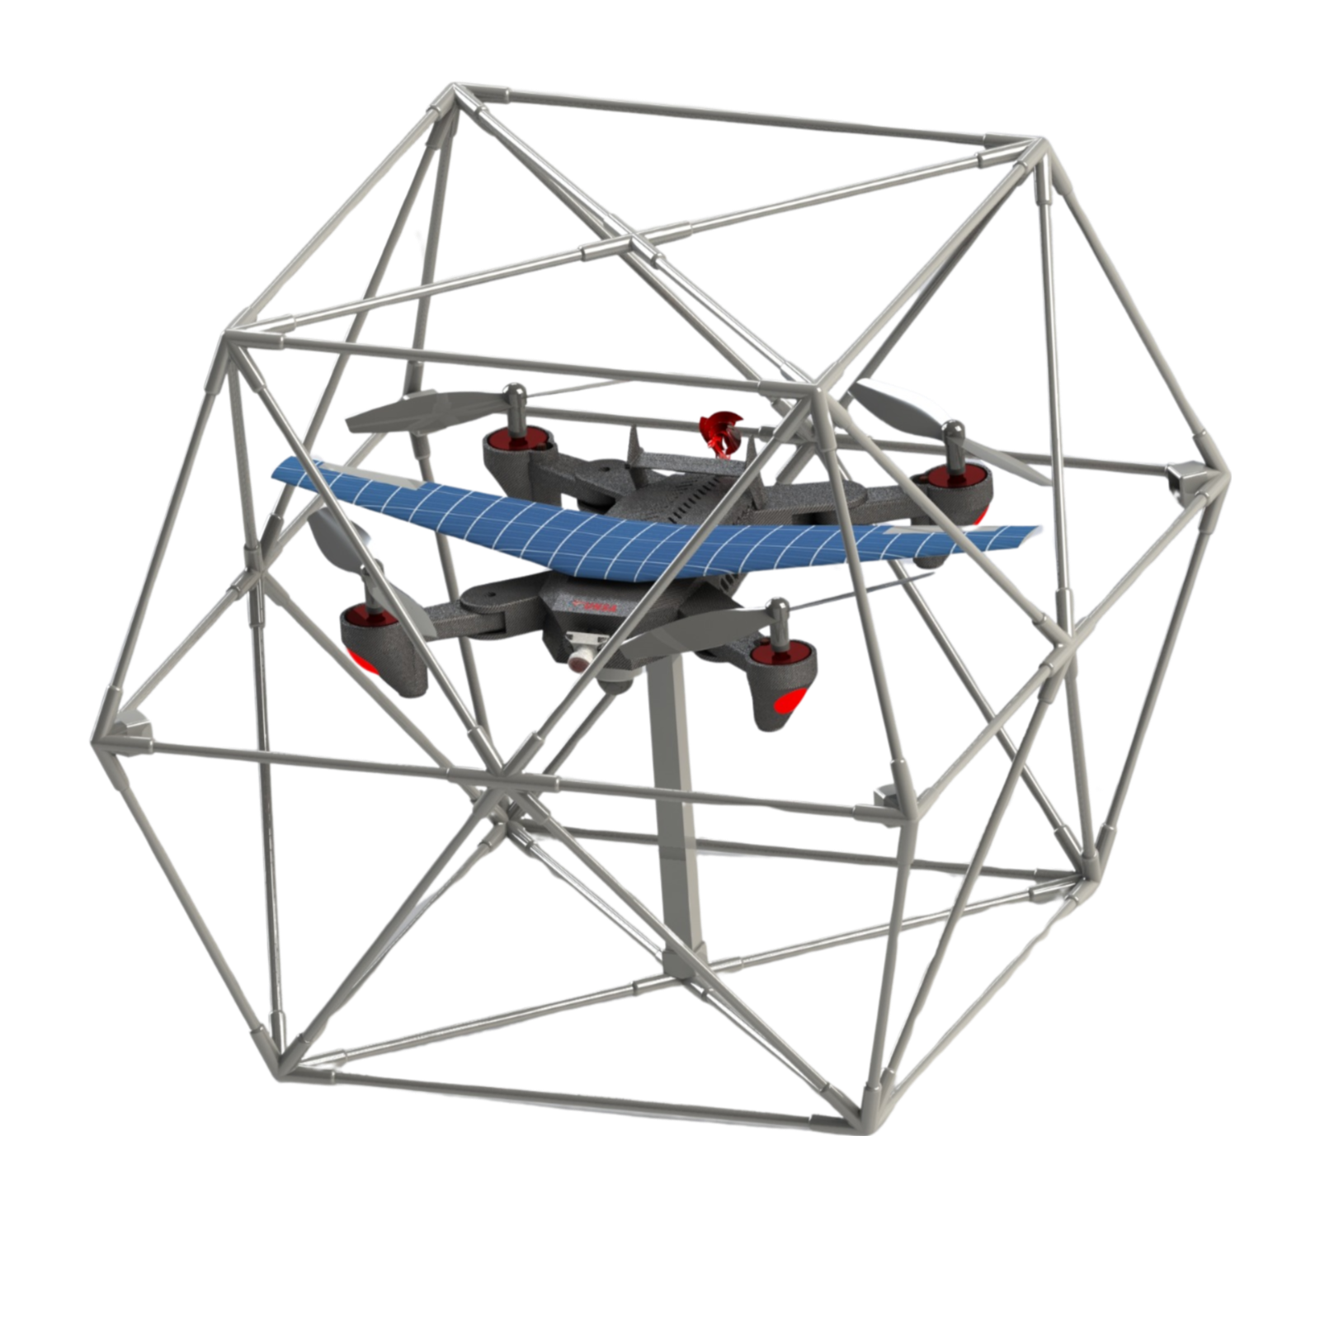


Managing Fire:
Increasing Community-based Fire Management Opportunities
TUNSA Space Robotics: Task Force 2
Participants:
Firas RAOUIN
Elyes KHECHINE
Med Yessine KSIBI
Mohamed Aziz NAIFAR
Yasmin LOUKIL
GitHub

Slide 2

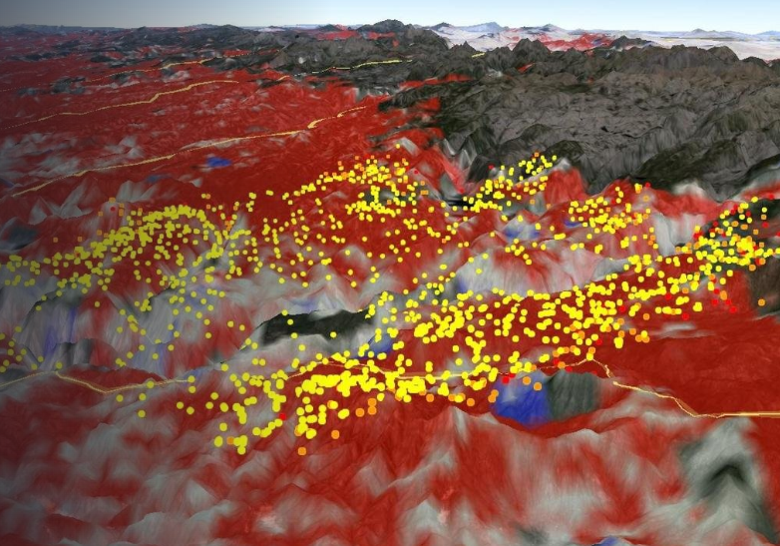
PROBLEM STATEMENT
In the face of increasing wildfires, the need for broader access to satellite-derived active fire data and its utilization by diverse stakeholder groups, including local communities, is pressing. Wildfires have devastating consequences, including biodiversity loss, air quality degradation, soil erosion, and greenhouse gas emissions, often disproportionately impacting communities residing near or within forests. To address this issue, our challenge is to find innovative ways to harness technology and publicly available data for fire and natural resource monitoring, enabling local communities to report and monitor fires, improve current data distribution, and develop community-based forest management solutions.

Slide 3

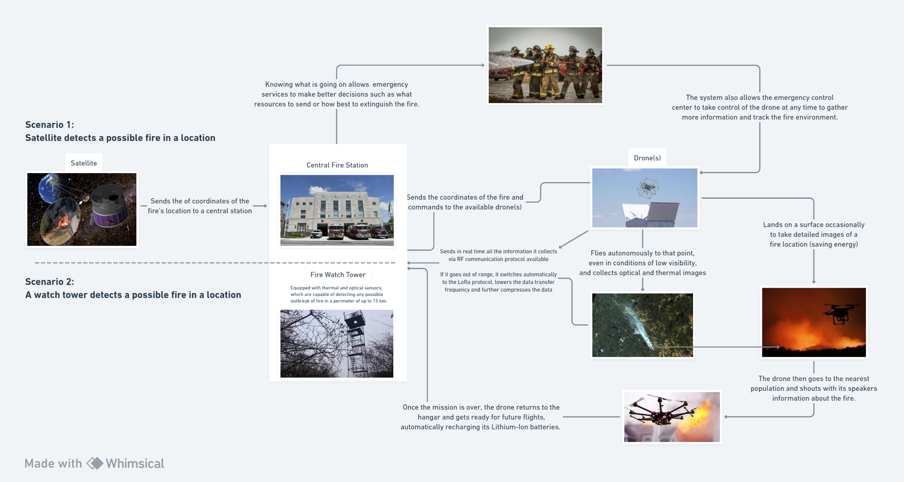
PROPOSED SOLUTION: FireFly Guardian
A Fire Verification, Monitoring, and Rescue Drone System

Slide 4
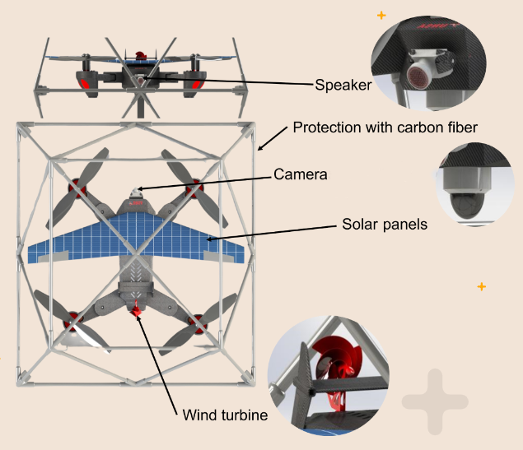

MECHANICAL DESIGN
- Aerodynamic Wings: Decreases power consumption during long flights.
- Solar Panels: Reduces reliance on the Lithium ion battery.
- Wind generator: Further boosts the battery life.
- Body Cage: Guarantees safety of the drone and the pedestrians.
- Carbon fiber body: Lowers body weight thus increasing flight times.
- 360° camera FOV: Cost-effective opposite-side 180° cameras for real-time monitoring.

Slide 5
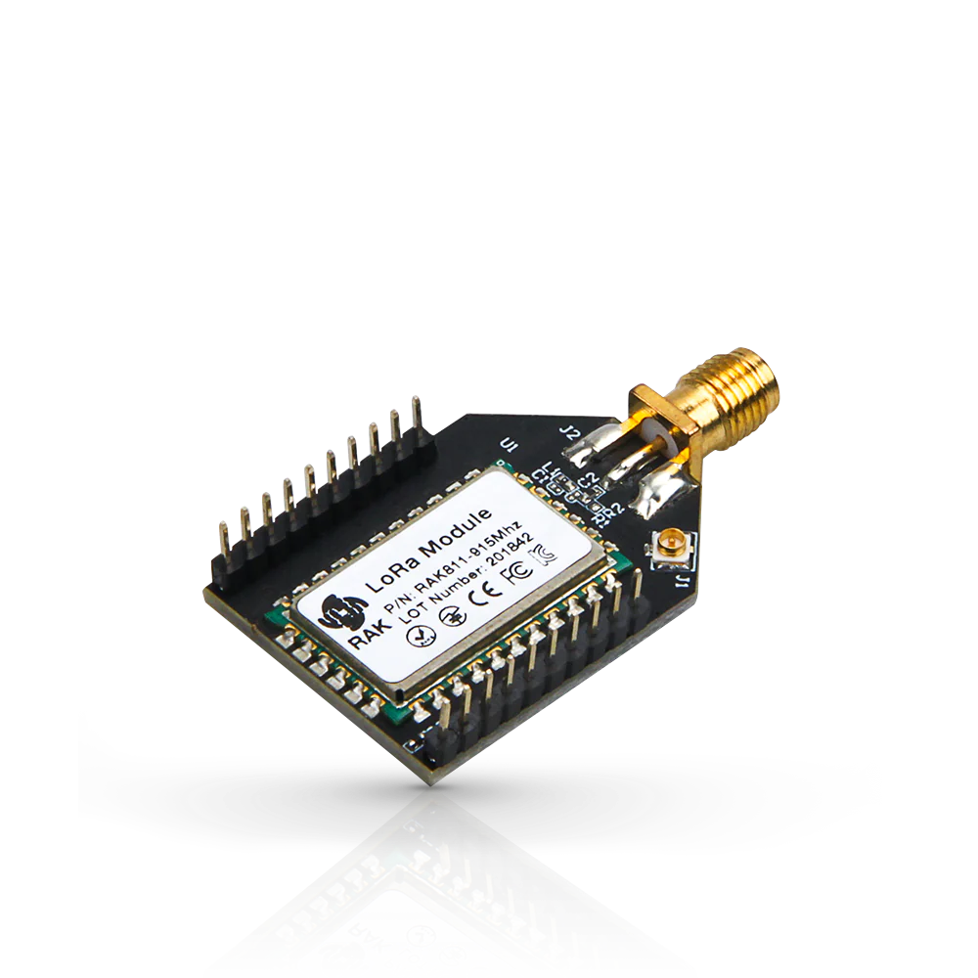
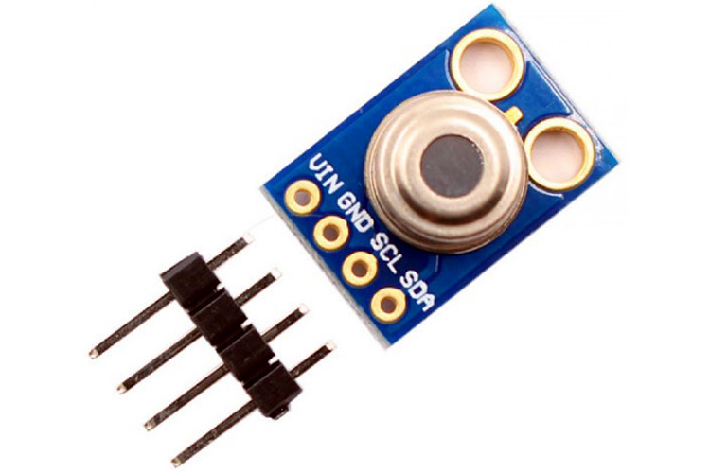
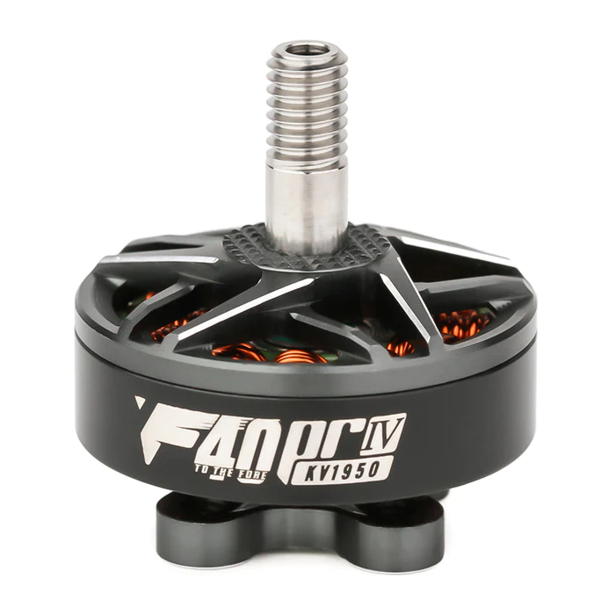
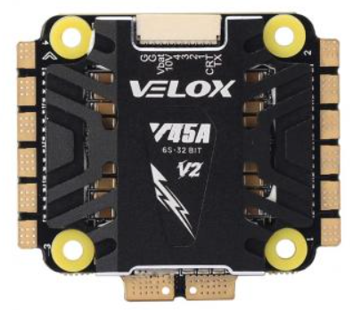

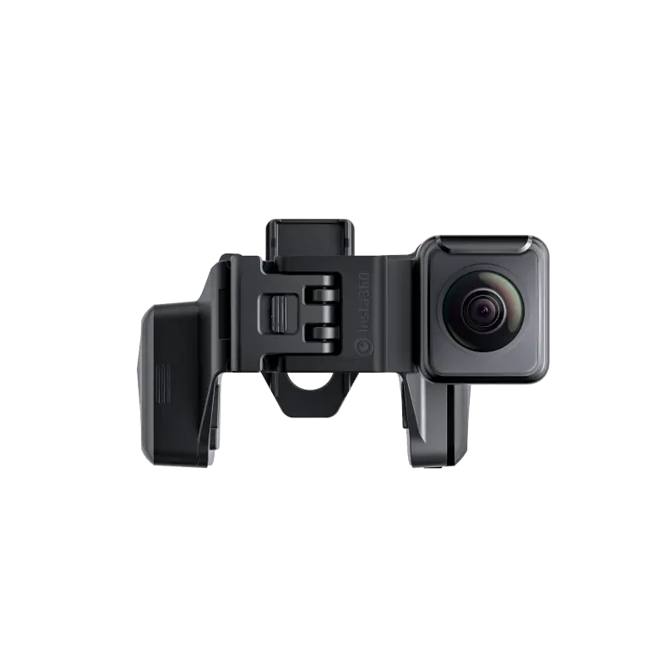
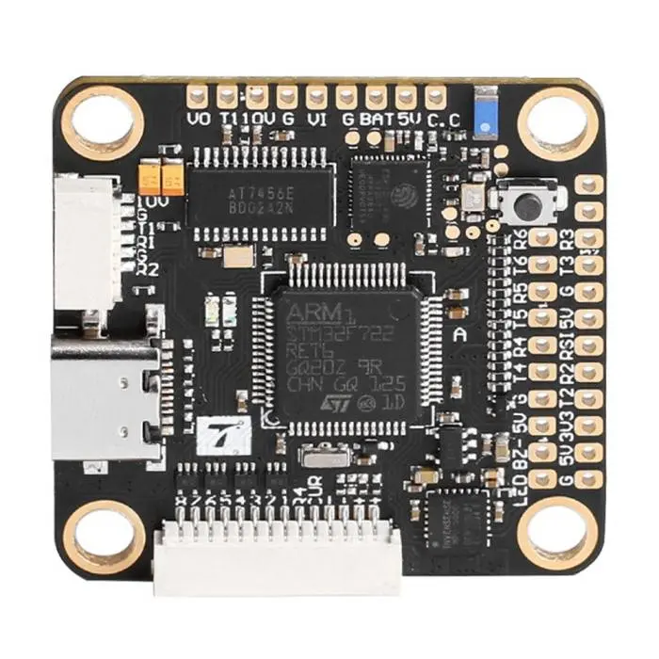
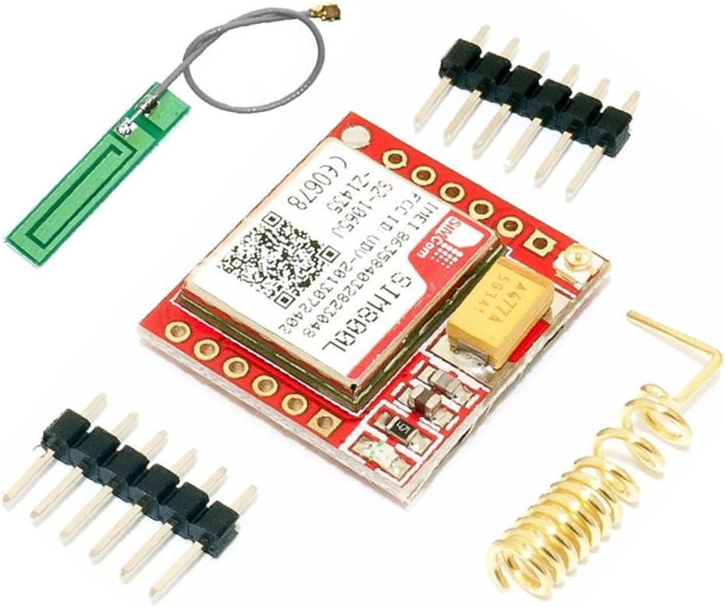
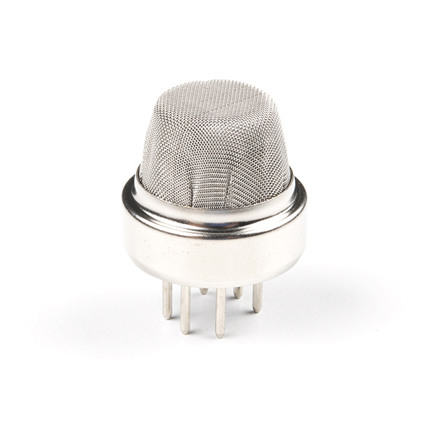
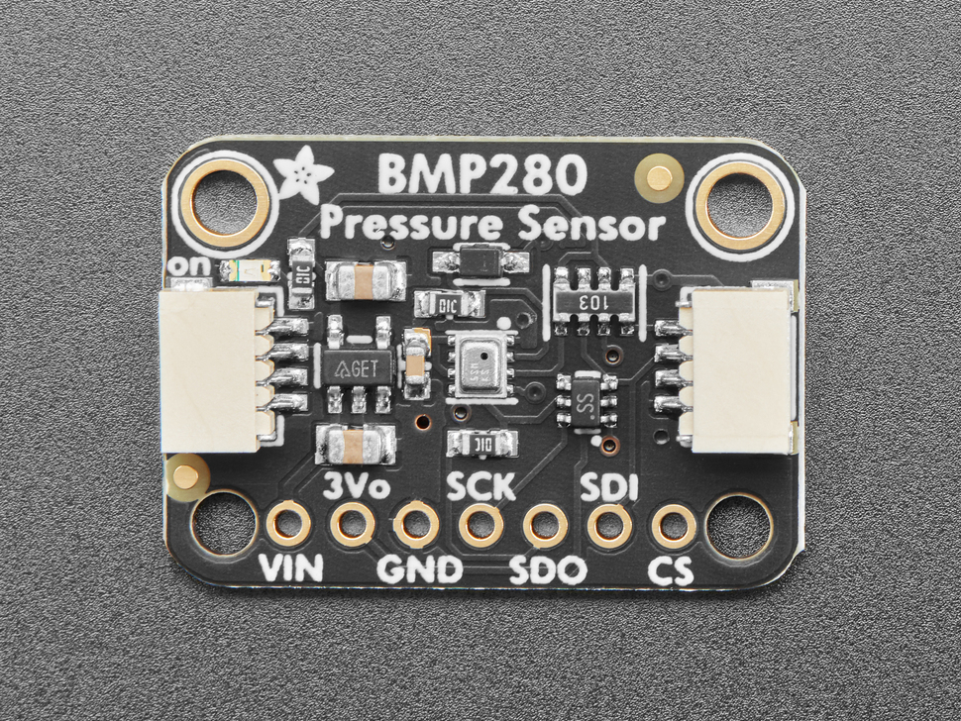
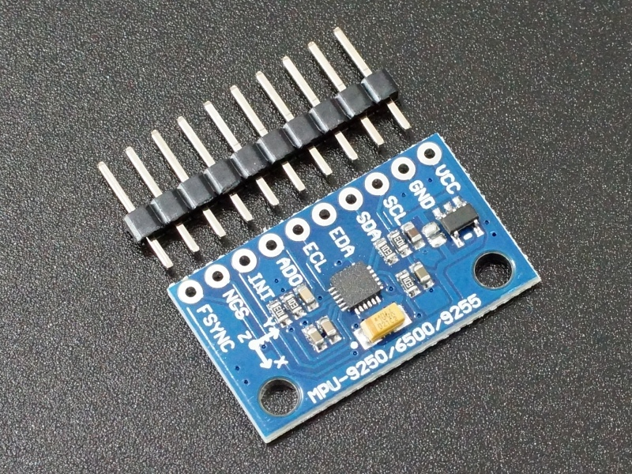
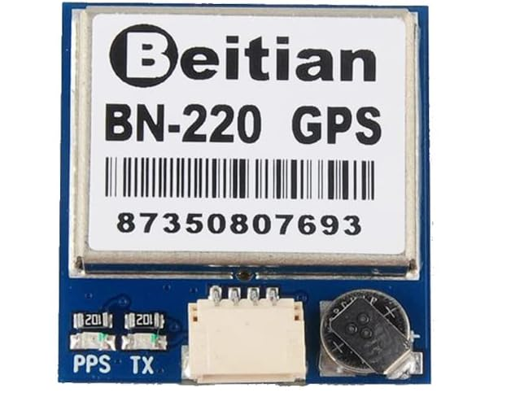
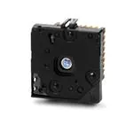
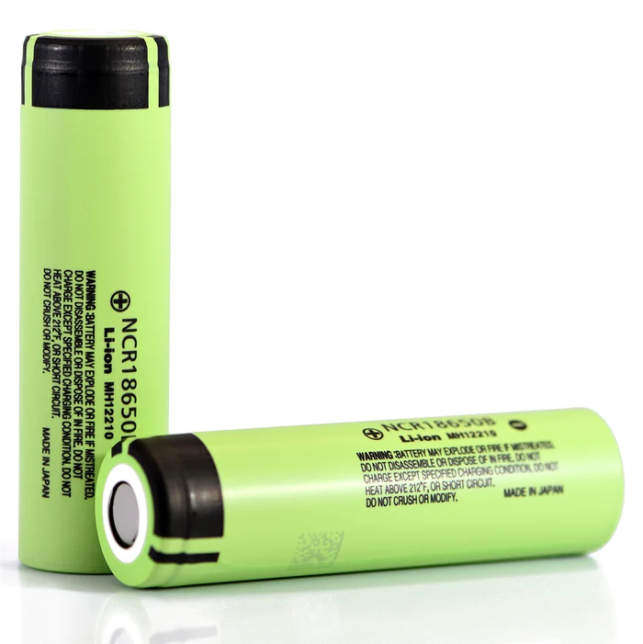
HARDWARE COMPONENTS
LoRa Module: Long-Range Communication, Low-Power
Temperature Sensor: Ambient Temperature, Measurement
Electronic Speed Controllers (ESCs): Speed Regulation, Feedback
Propellers: Blades, Lift, Rotation
Motors: Propulsion, Brushless, Thrust
GSM 3G Modem: Cellular Communication, GSM/UMTS
360° Camera: High-Resolution Imaging, Magnification
Flight Controller: Brain, Control, Communication
Smoke Sensor: Smoke Detection, Air Quality
Pressure Sensor: Atmospheric Pressure, Measurement
Gyroscope & Accelerometer: Measurement of Velocity, and Acceleration
GPS: Positioning, Satellite Signals
Thermal Camera: Infrared Imaging, Temperature
Lithium Ion Battery: Power Source, High Energy

Slide 6
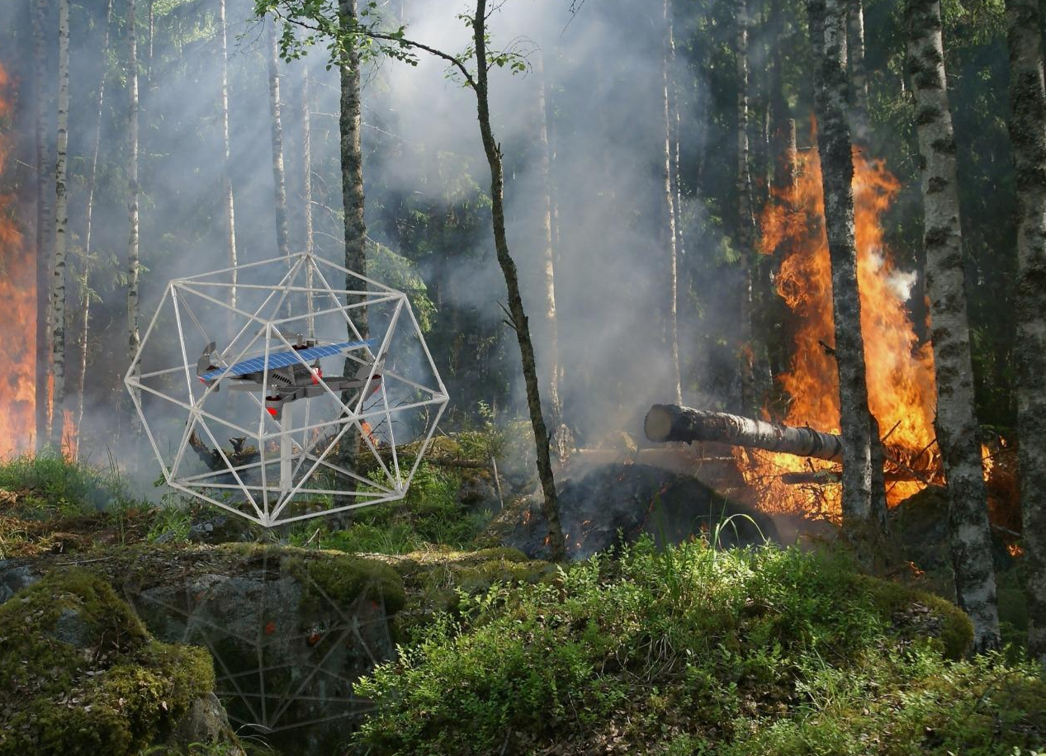
SOLUTION CHALLENGES
Surviving Harsh Environmental Conditions: Drones must endure extreme weather while ensuring the accuracy of sensors.
Navigating Complex Forest Terrain: Precision in dense canopies.
Meeting Regulatory Drone Compliance: Navigate airspace rules.
Gaining Community Acceptance: Addressing public concerns.

Slide 7

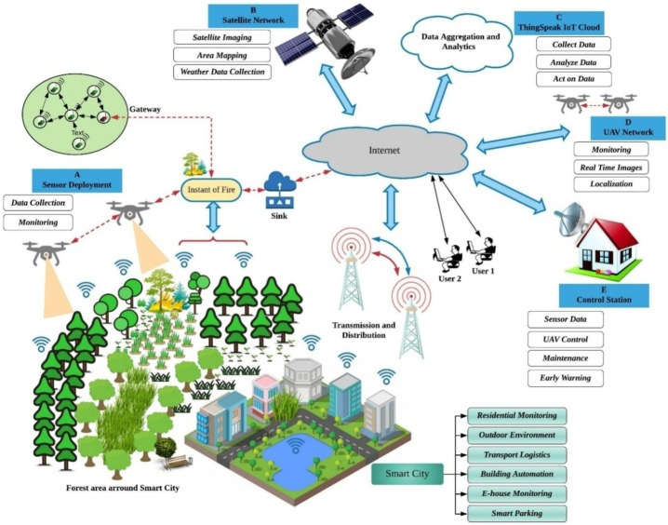
FUTURE WORK
Optimizing communication for faster and reliable signals.
Optimizing power consumption for extended flight endurance.
Leveraging machine learning for dynamic flight path planning.
Developing AI-driven predictive maintenance algorithms for reliability.
Implementing swarm intelligence for collaborative and efficient operations.

